Slide 1
CS 4476 Project 2
Jinghong Peng
Jpeng78@gatech.edu
903568613

Slide 2
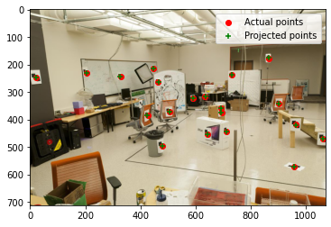
Part 1.5: Projection Matrix for provided image
<insert visualization of projected 3D points and actual 2D points for image provided by us here [1]>
<What is the minimum number of 3D-2D point correspondences needed to estimate the projection matrix? Why? [2]>
The minimum number of 3D-2D point correspondences is 4. The assumptions are optical center at (0,0). Unit aspect ratio, no skew, no rotation, camera at (0, 0, 0).

Slide 3
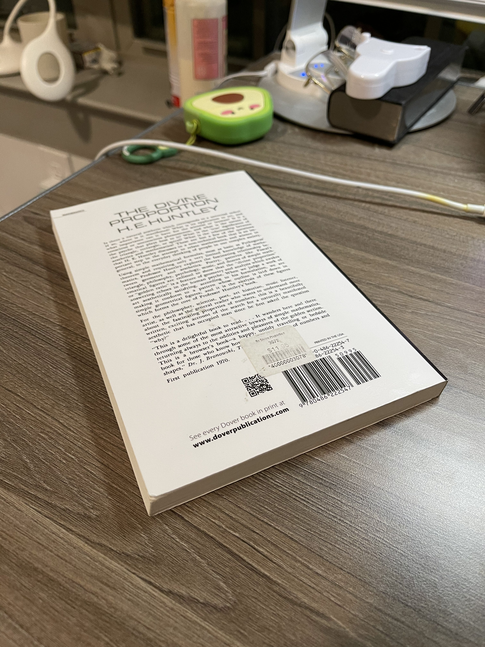
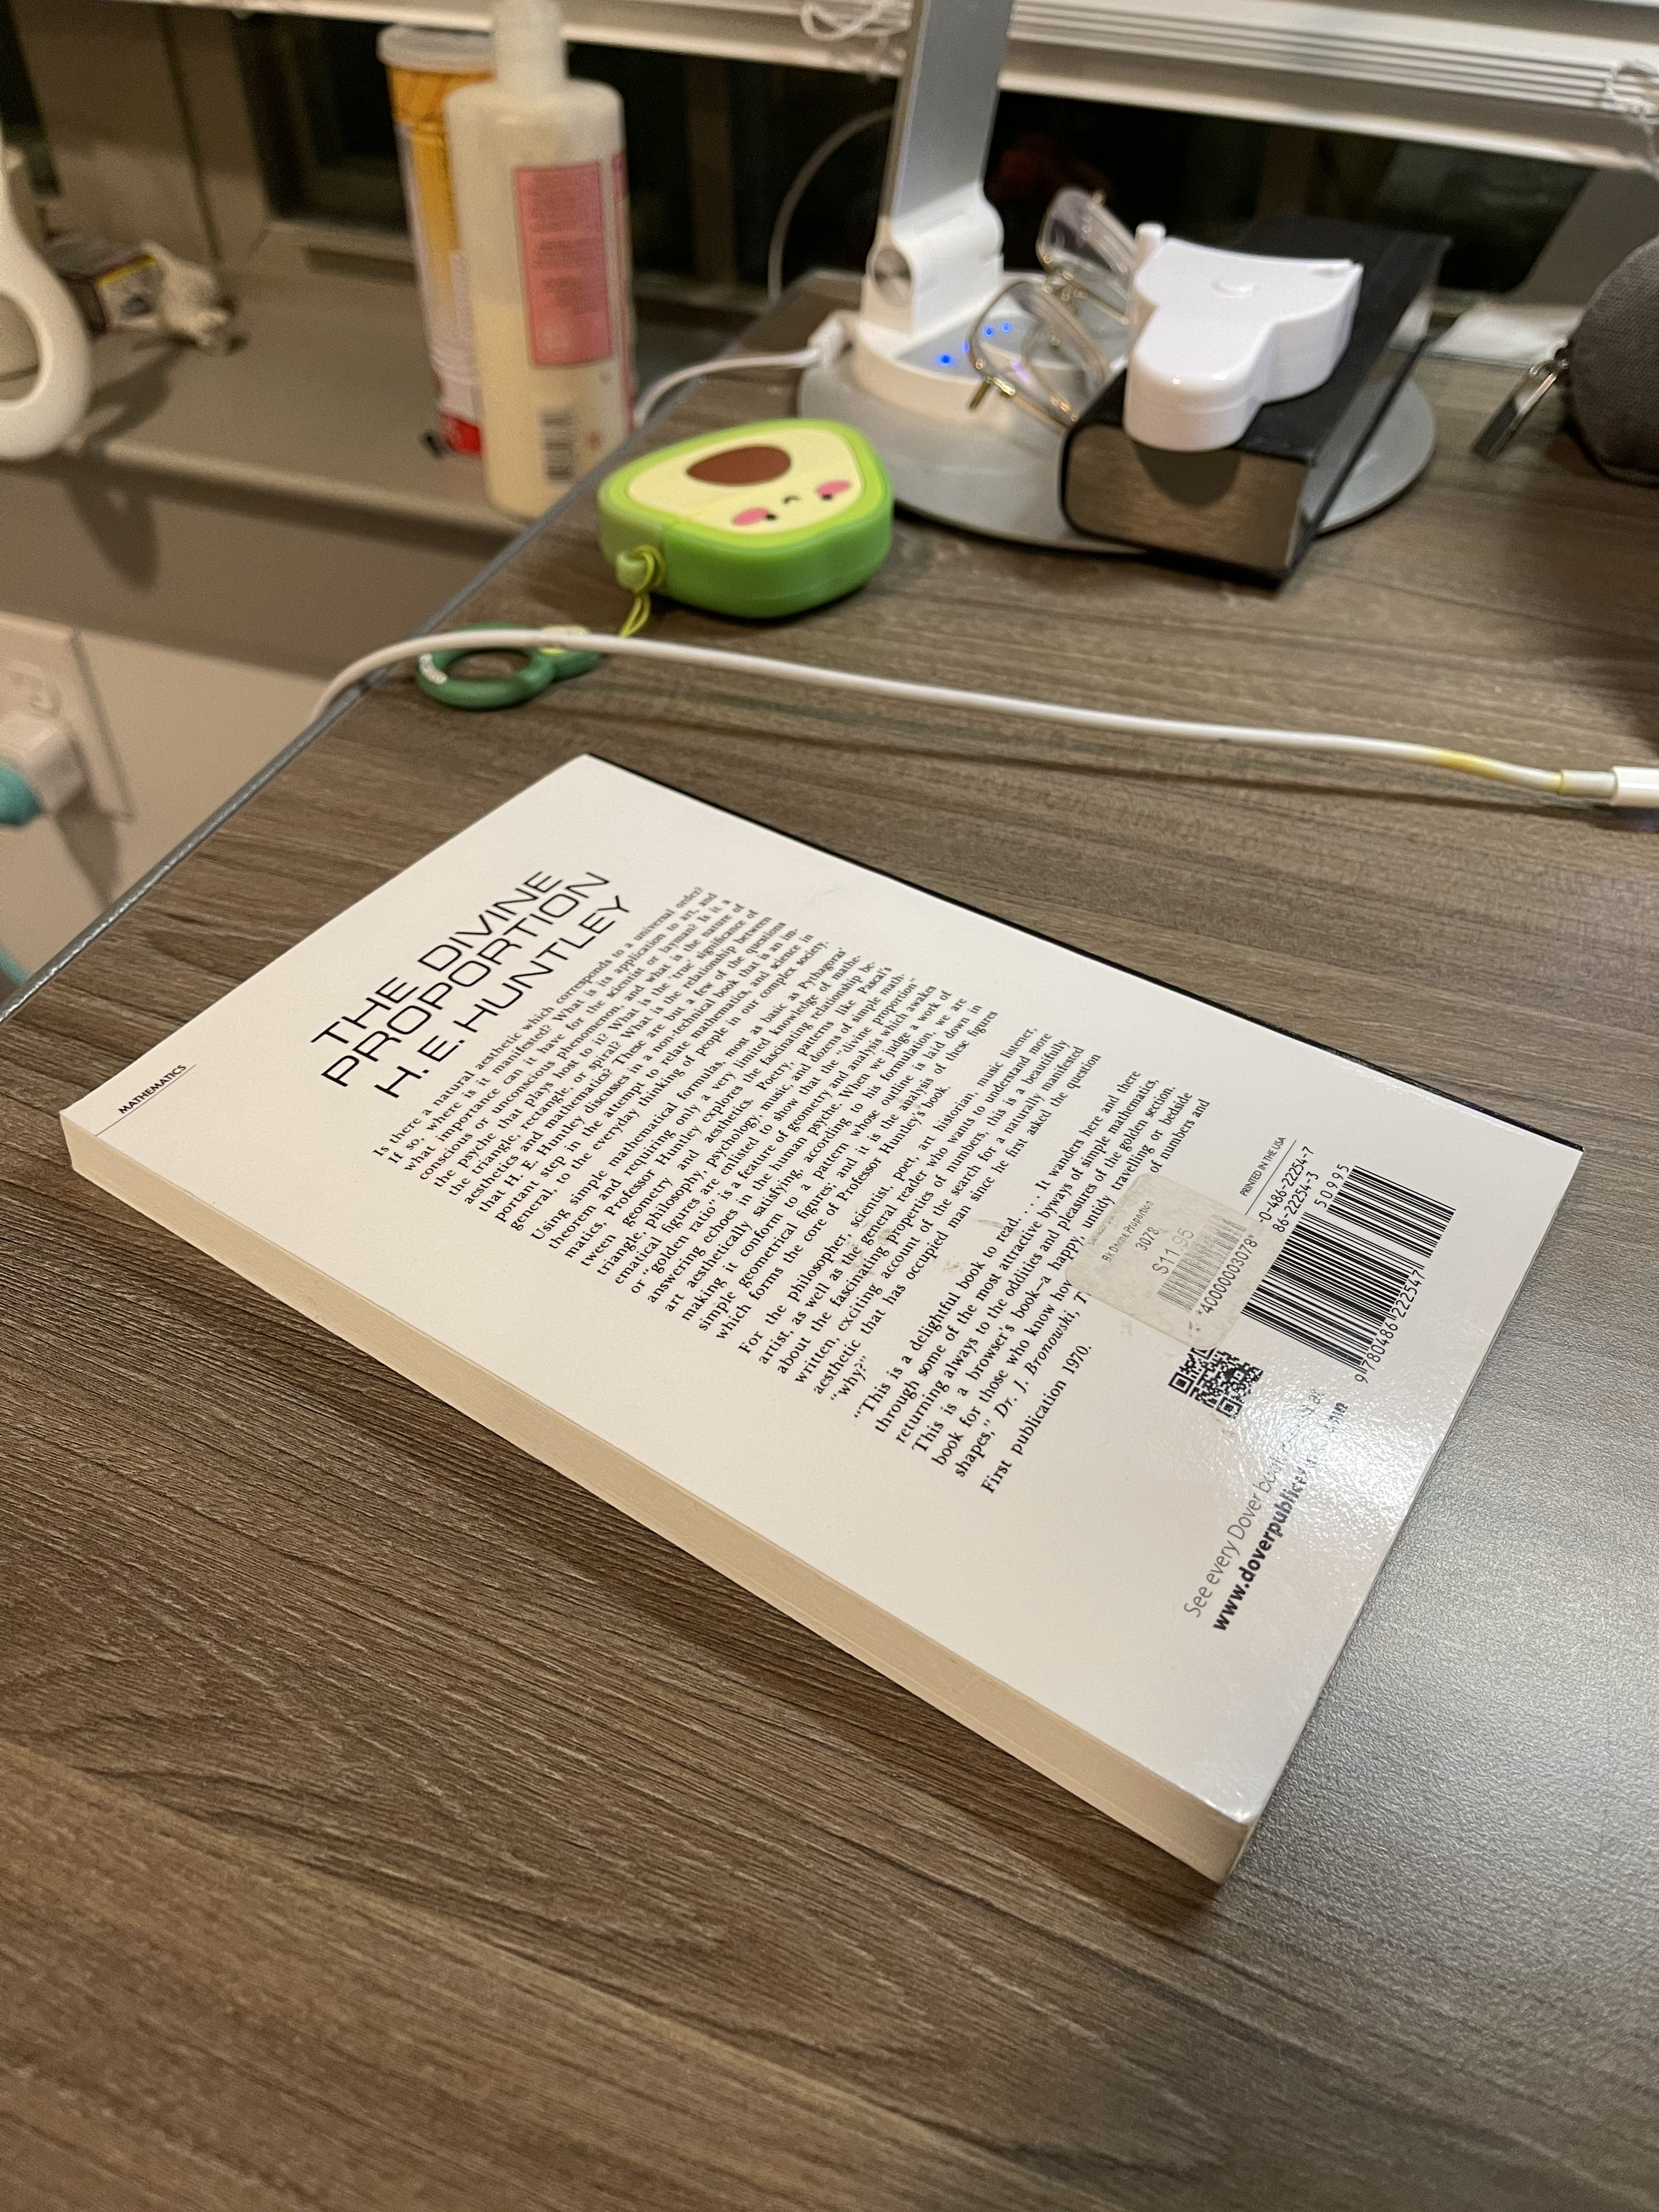
Part 2.1: Projection Matrix for custom images
image1
image2

Slide 4
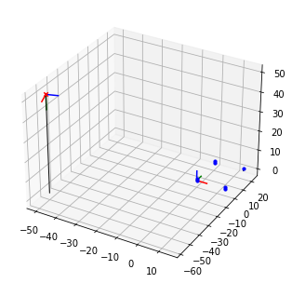
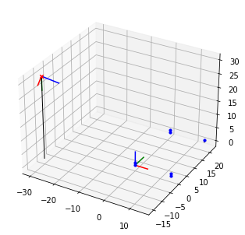
Part 2.2: Pose init for custom images
<Insert visualization for the initialized camera pose for 1st image> [1]
<Insert visualization for the initialized camera pose for 2nd image> [1]

Slide 5
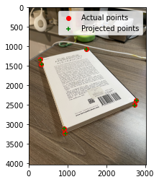
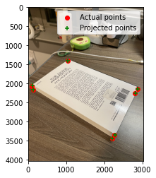
Part 2.2: Optimized results for custom images
<Insert visualization for projected 3D points and actual 2D points for 1st image> [1.5]
<Insert visualization for projected 3D points and actual 2D points for 2nd image> [1.5]

Slide 6
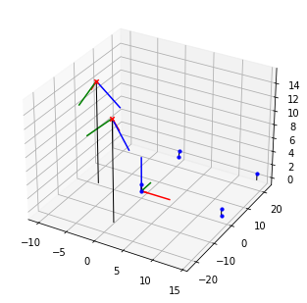
Part 2.3: Optimized Camera Poses
<Insert pose with world and optimized camera’s coordinate systems [1]>

Slide 7
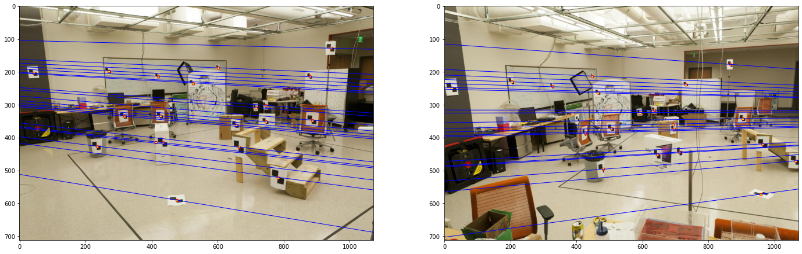
Part 3.2: Optimized Epipolar Lines (given images)
<Insert left image with epipolar lines> [1]
<Insert right image with epipolar lines> [1]

Slide 8
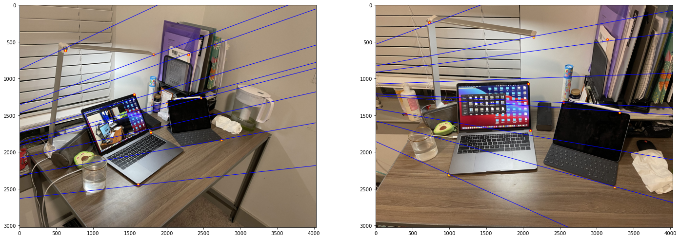
Part 3.3: Optimized Epipolar Lines (custom images)
<Insert left image with epipolar lines> [1.5]
<Insert right image with epipolar lines> [1.5]

Slide 9
Part 3.4: Reflection Questions [1x3]
1. Because the when I take images, the focal length and the principal points should equal to each other.
2. Points on both images can be projected onto the same epipolar plane. The nature of fundamental matrix is that it restrict projections onto epipolar lines. It is easier to search along the line than the whole image.
3. When camera centers are within the image, epipoles become camera center, and epipolar lines become points.

Slide 10
Part 3.4: Reflection Questions [1x3]
4. The two images are parallel to each other.
5. The fundamental matrix is defined by x'^t F * x = 0, once we find an F that can solve the equation. We can scale that F up by any factor and still solve the equation. The fundamental matrix is defined up to a scale.
6. Because epipoles are located on the epipolar lines, eF = 0, and thus F has a null space. F is constructed from the essential matrix E. E = [T×]R, where [T×] has rank 2, so F is also rank 2.

Slide 11
Part 4.2: RANSAC Iterations Questions [1x3]
Type your answers to the three RANSAC Iterations questions from the jupyter notebook below:
14
42
167

Slide 12
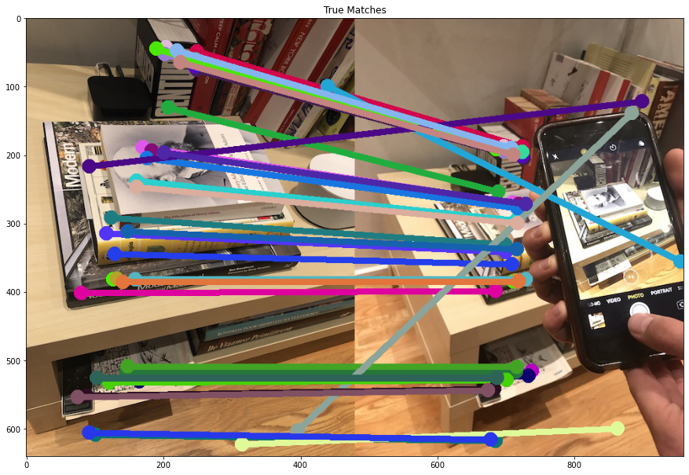
Part 4.4: RANSAC Inlier Matches
<Paste the inlier matches found by Ransac [2]>

Slide 13
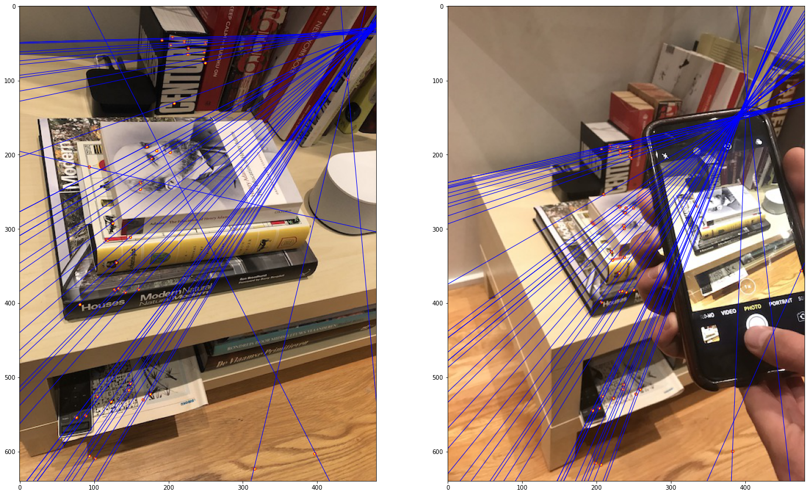
Part 4.4: RANSAC Epipolar Lines
<Paste the left image with epipolar lines> [1]
<Paste the right image with epipolar lines> [1]

Slide 14
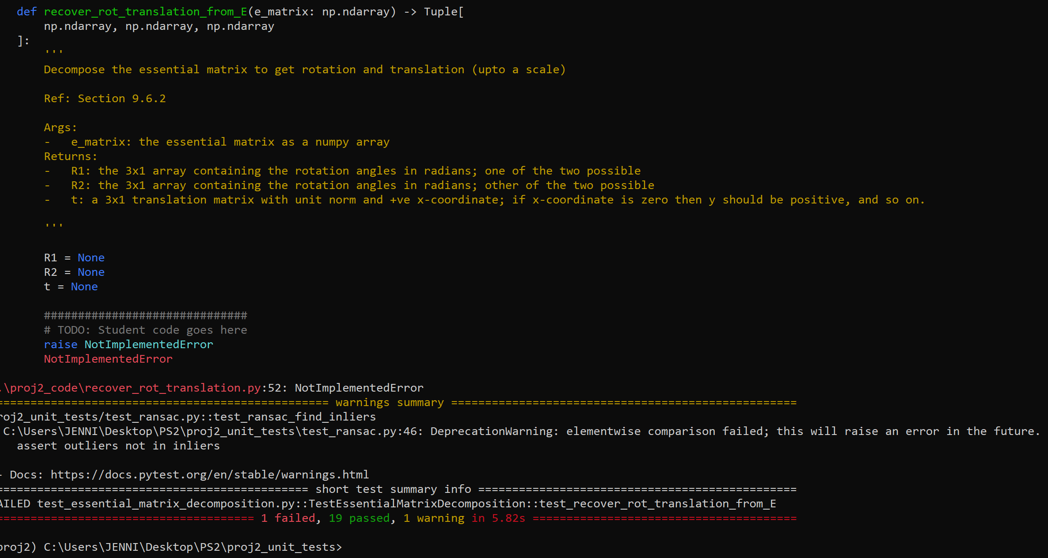
Local Unit tests results
<Paste the screenshot when you run all provided unit tests using `pytest`> [1]

Slide 15
Conclusions
<Describe what you have learned in this project. Feel free to include any challenges you ran into.> [2]
RANSAC is a powerful tool. It is also important to match the sequence of points of two images in part2. Selecting the right location of points is very important in optimizing epipolar lines.
Challenges: It takes a long time to reopen the Jupyter Notebook!

